Slide 1
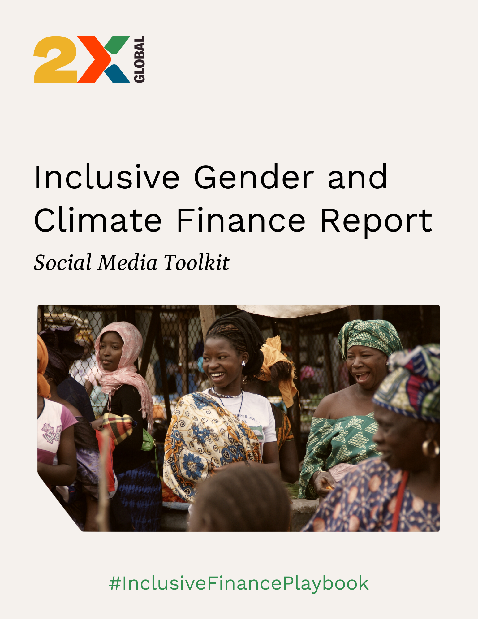

Slide 2

About this Toolkit
Inequality is a systemic risk. But inclusive gender and climate finance can help mitigate it, advancing resilience for the communities on the frontline of climate change.
This social media toolkit provides sample posts for Twitter and LinkedIn to share insights and recommendations of 2X Global’s latest report, highlighting the urgent need to centre underrepresented and underserved communities in investment.
The report is embargoed and not for external sharing or publication until 00.01 GMT on Tuesday, February 28. Once the embargo lifts, the report will be published online at [LINK], and can be promoted publicly via social media channels.
Download all the graphics here!
Want to share your support? Use the customisable quote card template! Here’s how:
Open this link.
Upload your image.
Click the placeholder image and right-click, selecting “Cut” to remove the box on the edges.
Drag the image over the sample image until it snaps into place.
Right-click again and paste the box over your image.
Add your name and organization.
Share with your networks!

Slide 3
Twitter posts
Investors can drive positive change through climate- and gender-smart finance 💡 Want to learn how? Check out @2x_global's #InclusiveFinancePlaybook: [LINK]
#DYK that in 2021, women founders of clean tech companies raised $26.1M compared to $10B by men? By filling gender gaps in finance, investors can help reduce the risk of climate-related shocks! Learn more in @2x_global's #InclusiveFinancePlaybook: [LINK]
Inequality is a systemic risk ❌ Through inclusive gender and climate finance, investors can help mitigate the disproportionate impacts of disaster and shocks. Find out how to get started in @2x_global's #InclusiveFinancePlaybook 👇 [LINK]
Women and frontline communities are often overlooked by investors. But #ClimateFinance that promotes #GenderEquality can diversify and strengthen markets 📈 Learn how to invest with an inclusive lens in @2x_global's #InclusiveFinancePlaybook 👇 [LINK]

Slide 4
Twitter posts
Women comprise 80% of climate refugees and the majority of the world's poor. ➡️ Despite women's potential and experience, investments for gender equality are underfunded. Learn how inclusive finance builds resilience in the #InclusiveFinancePlaybook: [LINK]
Climate finance that tackles #GenderInequality can... 📈 Diversify and strengthen the market ↘️ Reduce the risk of climate-related shocks 🌏 Improve economic stability Learn more in the #InclusiveFinancePlaybook from @2x_global 👇 [LINK]
These organisations put frontline communities at the centre of their work! 🔹 @SolarEnergyLoan 🔹 @EBRD 🔹 @juhudikilimo & @BlueOrchardLtd 🔹 @goodnatureagro and @GPSocialImpact 🔹 @InsuResilience 🔹 @UpayaSV Learn more in the #InclusiveFinancePlaybook: [LINK]

Slide 5
LinkedIn posts
Investors can drive positive change for #ClimateAction and #GenderEquality through more inclusive finance! The new #InclusiveFinancePlaybook from 2XGlobal helps investors identify opportunities for inclusive finance with multiple, overlapping benefits while also addressing systemic prejudices and inequities. Get all the insight and case studies here: [LINK]
Inequality is a systemic risk – but investors can help mitigate the potential impacts of disaster through inclusive gender and climate finance. Find out how to invest with an inclusive lens in 2XGlobal's new #InclusiveFinancePlaybook: [LINK] Featuring case studies from: Native Women Lead SELF (Solar and Energy Loan Fund) and CNote თბილისის სატრანსპორტო კომპანია/Tbilisi Transport Company and EBRD Juhudi Kilimo and BlueOrchard Finance Ltd Good Nature Agro and Global Partnerships InsuResilience Global Partnership Global Endowment Management Upaya Social Ventures

Slide 6
Social Media Handles
Name | Twitter Handle | LinkedIn Name
2XGlobal | @2X_global | 2XGlobal
Matriarch Revolutionary Fund |  | Native Women Lead
KL Felicitas Foundation (KLF)
SELF (Solar and Energy Loan Fund) | @SolarEnergyLoan | SELF (Solar and Energy Loan Fund)
CNote | @goCNote | CNote
Tbilisi Transport Company |  | თბილისის სატრანსპორტო კომპანია/Tbilisi Transport Company
EBRD | @EBRD | EBRD
Juhudi Kilimo | @juhudikilimo | Juhudi Kilimo
BlueOrchard | @BlueOrchardLtd | BlueOrchard Finance Ltd
Good Nature Agro | @goodnatureagro | Good Nature Agro
Global Partnerships | @GPSocialImpact | Global Partnerships
InsuResilience | @InsuResilience | InsuResilience Global Partnership
Global Endowment Management |  | Global Endowment Management
Upaya Social Ventures | @UpayaSV | Upaya Social Ventures

